Slide 1

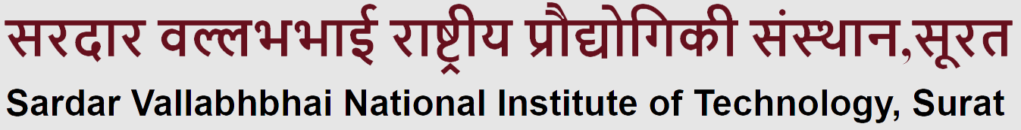
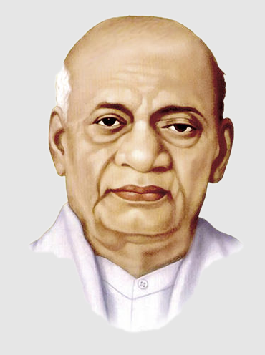
AICHAT
MOTIVE :-
We got bored of talking to the same old serious AI. So we thought, “Why not build a chatbot with multiple personalities — just like our friend group? Our goal was to make AI feel more human, relatable and fun.
ABHIMANYU (U24CS053) | AAYUSH (U24CS058)
ROHIT YADAV (U24CS050) | ANUJ (U24CS044)
SUBMITTED TO : MRS. RASHMI PANDEY

Slide 2

INTRODUCING AICHAT
Welcome to AICHAT, an advanced multi-persona Al chatbot built to provide a personalized and engaging conversation experience. Whether you're looking for help, humor, companionship, or wisdom-AICHAT has it all.
Our website is crafted with a vibrant and intuitive interface, providing seamless access to four powerful personas-each with a unique identity and purpose.

Slide 3

NEVOX AI
NevoxAI is designed as a general, all-in-one assistant that can handle a variety of tasks across different personas. It is your all-in-one assistant. From productivity to learning. Nevox has your back!

Slide 4



PERSONAS
VeeVee
VeeVee AI is your flirtatious, cute virtual AI girlfriend who’s always ready to send you sweet messages and make you smile with every chat.
Baba Tillu AI is your chill, spiritual homie. With wisdom for days and a calming vibe, it’s here to guide you through life’s ups and downs
BbgAI is the ultimate roast master, throwing savage burns and making sure you're laughing (or crying) in the process.

Slide 5


What Powers AICHAT
The brain behind the bot! Powered our backend logic, managed API calls, and delivered responses for each AI persona using Streamlit and custom AI logic.
PYTHON
The backbone of our website — it structures all the content, layouts, and elements that make up each page of AICHAT.
HTML
Brought AICHAT to life on the frontend! Handled dynamic interactions like switching personas, chatbot animations, form validation, and ensured the site responds well across devices.
Styled the entire frontend with custom components, animations, responsive layouts, and maintained the blue theme across all pages for a cohesive visual experience.
CSS
JAVASCRIPT

Slide 6



